Slide 1
ANATOMY OF SCADA RISK:
Leveraging Lifesaving Epidemic Models for a Novel Evaluation of SCADA/ICS Risks
January 2020
Yehonatan Kfir, CTO
Yehonatan_k@radiflow.com

Slide 2
Agenda
Introduction
The Biology Model
OT Risk Assessment
Implementation, following NIST Framework
Summary

Slide 3

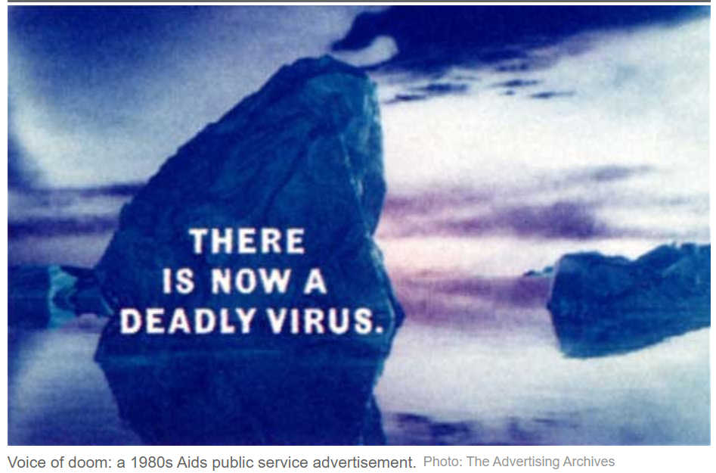

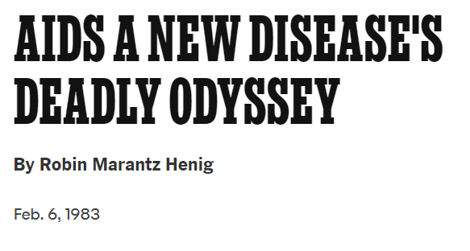
1970s
At the 1970s, a new threat to humans was raised.
It is going to kill about 50% of the infected.
More than 35 Million people will die.
AIDS

Slide 4


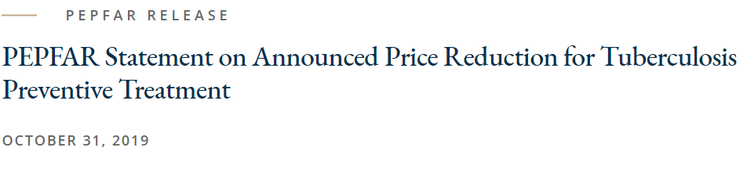
1970 - 2020
Collaboration
Threat Research
Optimized Mitigations

Slide 5

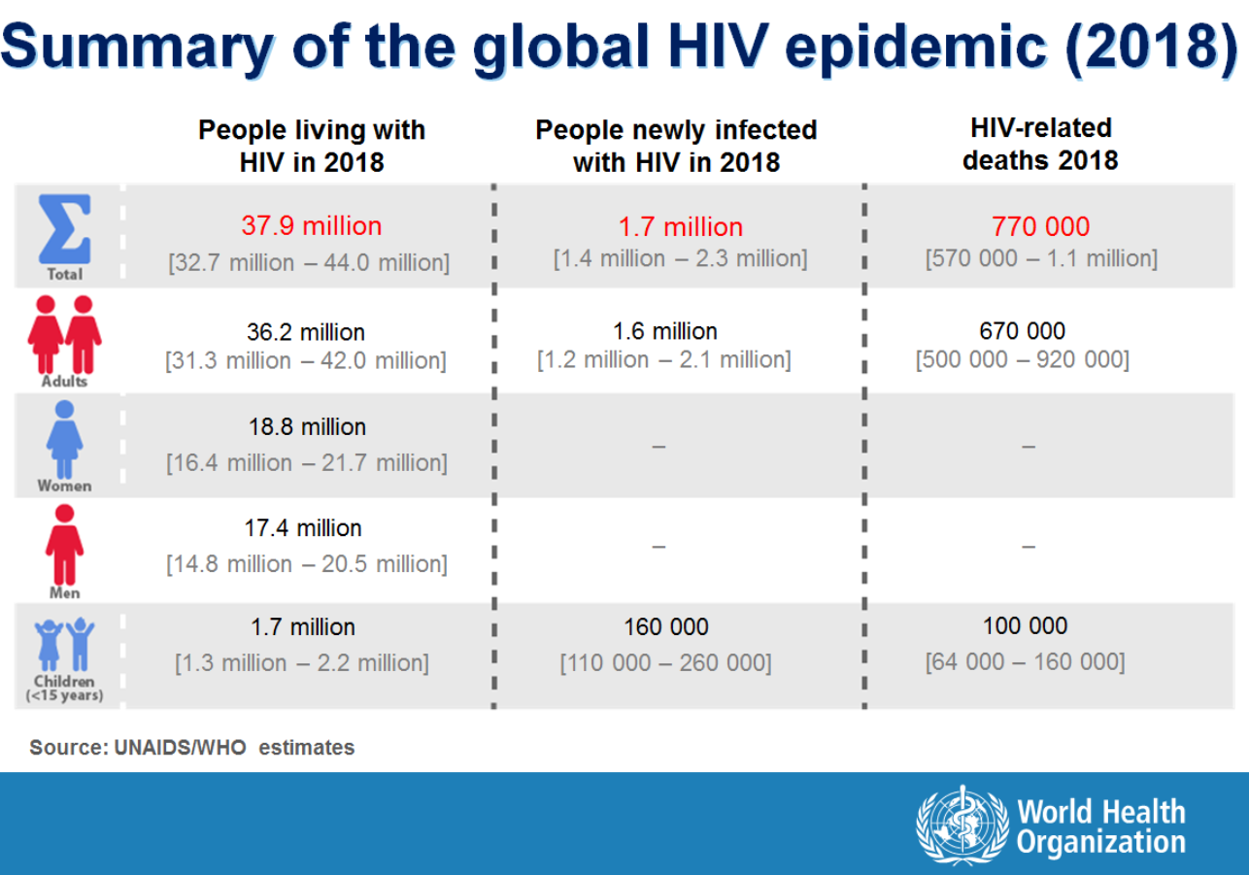
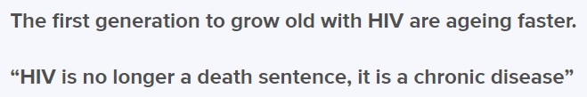

2010s
Inspiring!

Slide 6
The Journey
What can we learn from that to the Cyber world?
How did they prioritize efforts?
Can we apply those methods to Cyber Security?
Can we make Cyber threats
“chronic but not a death sentence”
to our physical processes?

Slide 7
The Journey
What can we learn from that to the Cyber world?
How did they prioritize efforts?
Can we apply those methods to Cyber Security?
Can we make Cyber threats
“chronic but not a death sentence”
to our physical processes?
Epidemic Models

Slide 8

Diving to the Biology Model
Given a social network
  Nodes represent persons
  Links represent who has the potential to infect whom
What are we able to predict regarding the potential of this population being infected by a given virus?

Slide 9

Example: SIS Model
Each node, at each time step t, is either
  Susceptible
  Infective
Infected by neighbor
Resist Infection
Not Cured
Susceptible
Infective
Cured

Slide 10




Example: SIS Model
Each node, at each time step t, is either
  Susceptible
  Infective
$$1−ζ$$
Infected by neighbor
Resist Infection
Not Cured
$$1−δ$$
$$ζ$$
Susceptible
Infective
$$δ$$
Cured

Slide 11
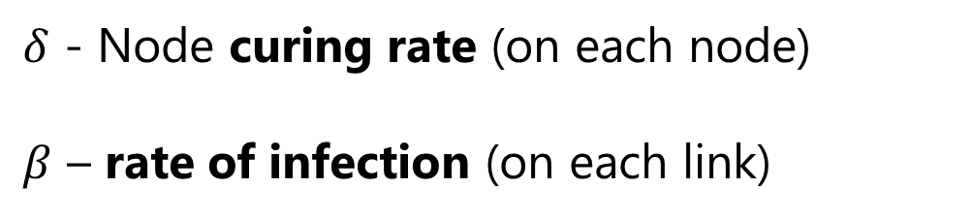
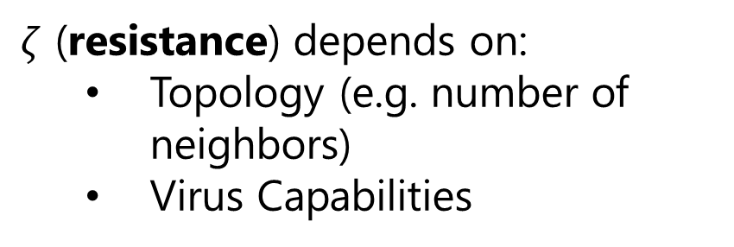
Example: SIS Model
$ζ$ (resistance) depends on:
  Topology (e.g. number of neighbors)
  Virus Capabilities
$δ$ - Node curing rate (on each node)
$β$ – rate of infection (on each link)
$$1−ζ$$
Infected by neighbor
Resist Infection
Not Cured
$$1−δ$$
$$ζ$$
Susceptible
Infective
$$δ$$
Cured

Slide 12

Epidemic Threshold
Defined as the minimum level of virulence to prevent a viral contagion from dying out quickly
$$τ$$
For Example:
Malaria: 1.5 times the baseline over the previous 3 weeks.

Slide 13
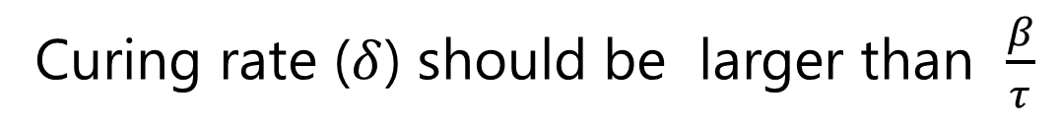
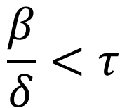
Example: SIS Model
$ζ$ (resistance) depends on:
  Topology (e.g. number of neighbors)
  Virus Capabilities
$δ$ - Node curing rate (on each node)
$β$ – rate of infection (on each link)
$$\frac{β}{δ}<τ$$
Viral outbreak dies out quickly if:
Epidemic Threshold
Curing rate ($δ$) should be larger than $\frac{β}{τ}$

Slide 14
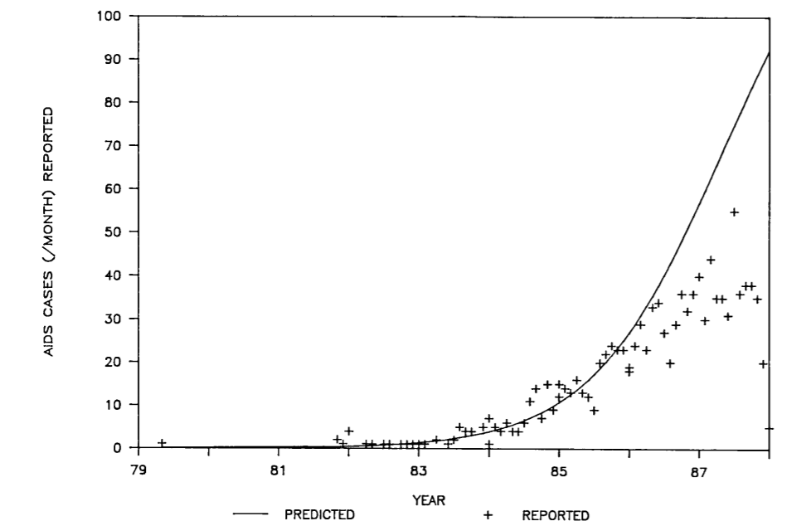
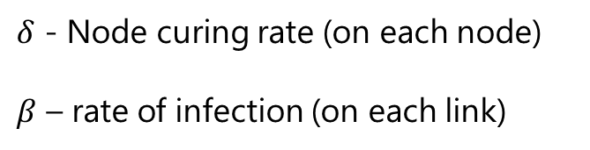
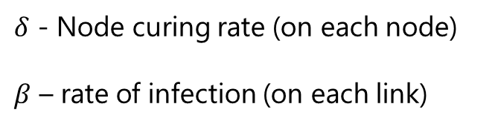
SIS Model for AIDS
Infection Data
Estimate SIS Parameters
Predict Future Infection
Improve Curing Rate
$$\frac{β}{δ}<τ$$
𝛽/𝛿<𝜏
$δ$ - Node curing rate (on each node)
$β$ – rate of infection (on each link)
$δ$ - Node curing rate (on each node)
$β$ – rate of infection (on each link)
Graph taken from: Anderson, R.M., 1988. The role of mathematical models in the study of HIV transmission and the epidemiology of AIDS. Journal of Acquired Immune Deficiency Syndromes, 1(3), pp.241-256.

Slide 15

SIS Model for AIDS
Infection Data
Estimate SIS Parameters
Predict Future Infection
Improve Curing Rate
$$\frac{β}{δ}<τ$$
𝛽/𝛿<𝜏
Epidemic Threshold
$δ$ - Node curing rate (on each node)
$β$ – rate of infection (on each link)
Graph taken from: Anderson, R.M., 1988. The role of mathematical models in the study of HIV transmission and the epidemiology of AIDS. Journal of Acquired Immune Deficiency Syndromes, 1(3), pp.241-256.

Slide 16
SIS Model for AIDS
Infection Data
Estimate SIS Parameters
Predict Future Infection
Improve Curing Rate
$$\frac{β}{δ}<τ$$
𝛽/𝛿<𝜏
Epidemic Threshold
There is even more…
Graph taken from: Anderson, R.M., 1988. The role of mathematical models in the study of HIV transmission and the epidemiology of AIDS. Journal of Acquired Immune Deficiency Syndromes, 1(3), pp.241-256.

Slide 17



Epidemic Threshold
Not all viruses behave the same
  There are several epidemic models.
Research from 2012 shows that the epidemic thresholds of all models are related to the network topology!
$λ −$ “Leading Eigenvalue of the network graph”
Epidemic Threshold
Network Topology
$$τ$$
$$λ$$
Prakash, B.A., Chakrabarti, D., Valler, N.C., Faloutsos, M. and Faloutsos, C., 2012. Threshold conditions for arbitrary cascade models on arbitrary networks. Knowledge and information systems, 33(3), pp.549-575

Slide 18
Epidemic Threshold
Data on the Population
Calculate $λ$
Calculate 𝜆
Reduce $λ$
Reduce 𝜆
Epidemic Threshold
Network Topology
$$τ$$
$$λ$$

Slide 19
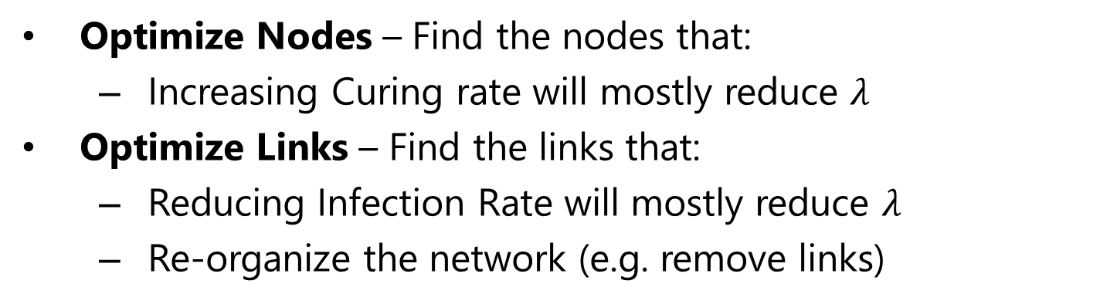
Epidemic Threshold
Data on the Population
Calculate $λ$
Calculate 𝜆
Reduce $λ$
Reduce 𝜆
Optimize Links
Optimize Nodes
Optimize Nodes – Find the nodes that:
  Increasing Curing rate will mostly reduce $λ$
Optimize Links – Find the links that:
  Reducing Infection Rate will mostly reduce $λ$
  Re-organize the network (e.g. remove links)

Slide 20
The Journey
What can we learn from that to the Cyber world?
How did they prioritize efforts?
Can we apply those methods to Cyber Security?
Can we make Cyber threats
“chronic but not a death sentence”
to our physical processes?

Slide 21
OT Risk Assessment
There is a word in most of the standards…
which actually can be a book….

Slide 22
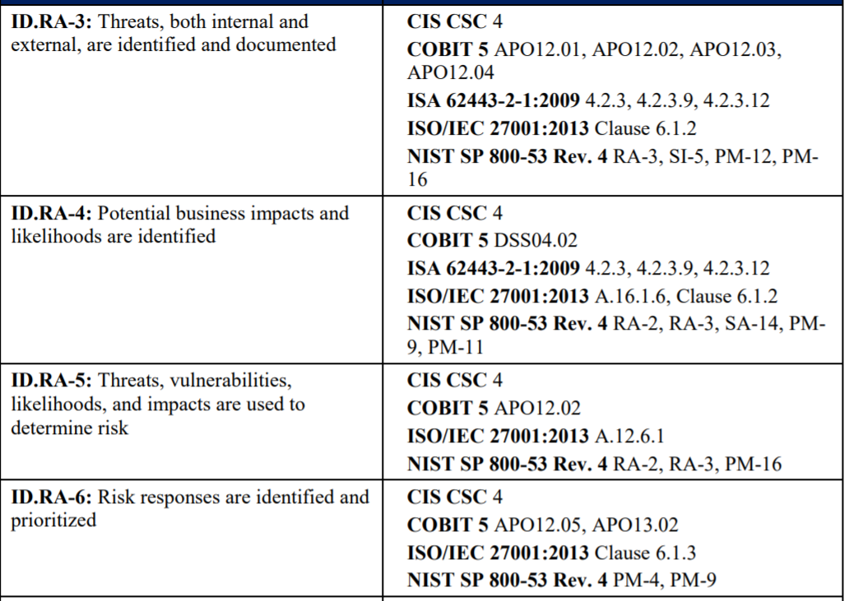
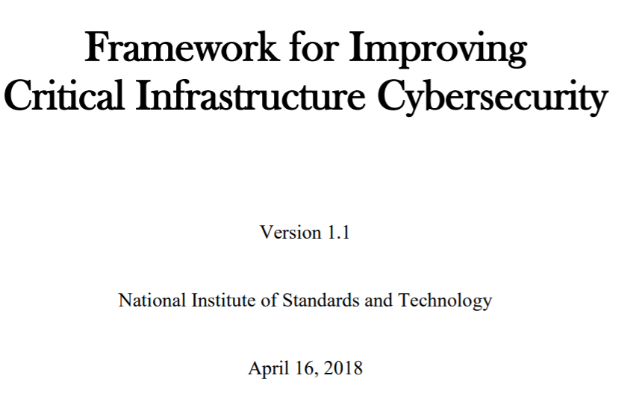
OT Risk Assessment
There is a word in most of the standards…
which actually can be a book….
Likelihood

Slide 23

Likelihood
Impact – we can think of ways to estimate.
But, how to estimate Likelihood?
Risk = Impact $×$ Likelihood

Slide 24
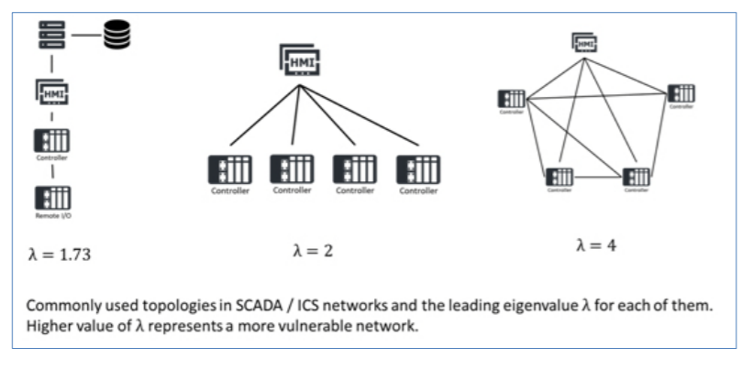

Likelihood
Impact – we can think of ways to estimate.
But, how to estimate Likelihood?
Risk = Impact $×$ Likelihood
$$λ$$
Digital Production Image

Slide 25

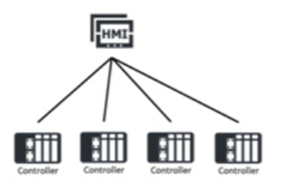

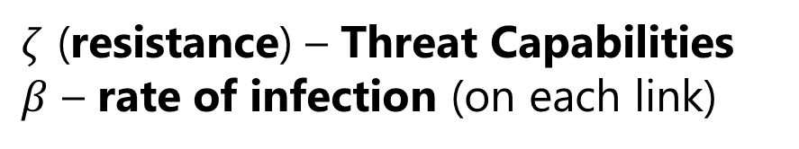

Likelihood - $ζ$ , $β$
What types of attackers do we have?
APT
Hacking Groups
How do they operate?
Only through servers? Or also through PLC?
Are they using Zero-days vulnerabilities or not?
Translating the attacks to technical measurable activities.
$ζ$ (resistance) – Threat Capabilities
$β$ – rate of infection (on each link)
Threat Intel
1.2
0.7
0.2
1.2

Slide 26

Risk Assessment
Business Process
Criticality
Digital Production Image
$$λ$$
Risk
=
Impact
X
Likelihood

Slide 27
Implementation

Slide 28
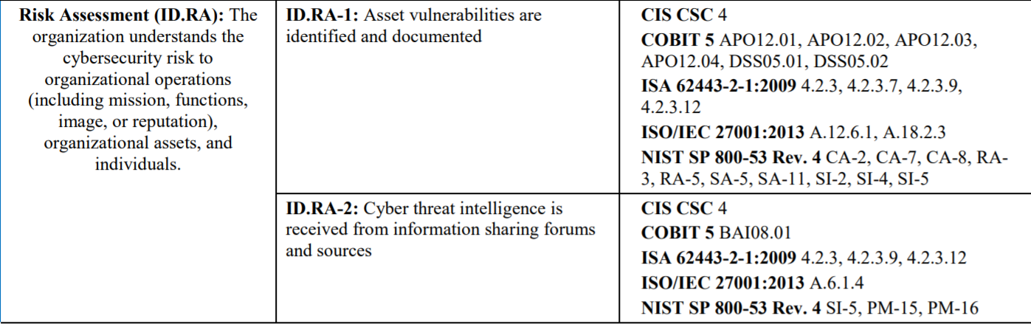
OT Risk Assessment - NIST
Digital Production Image

Slide 29
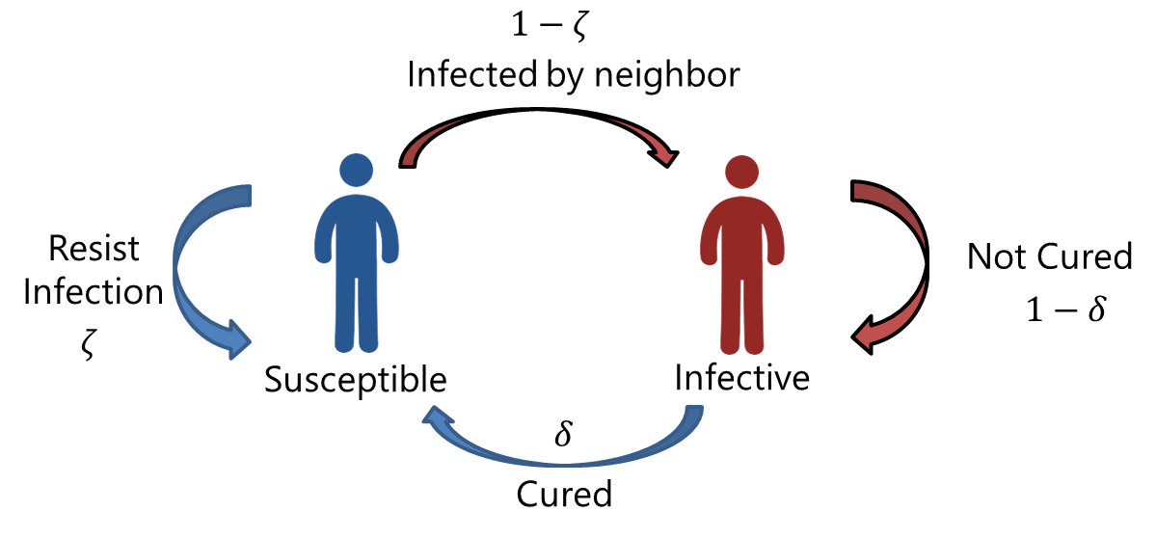
OT Risk Assessment - NIST
Business Process
Criticality

Slide 30
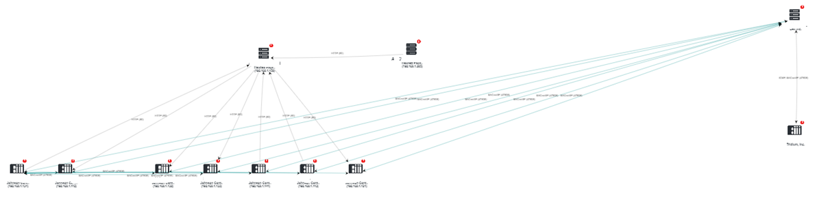
The Digital Production Image

Slide 31
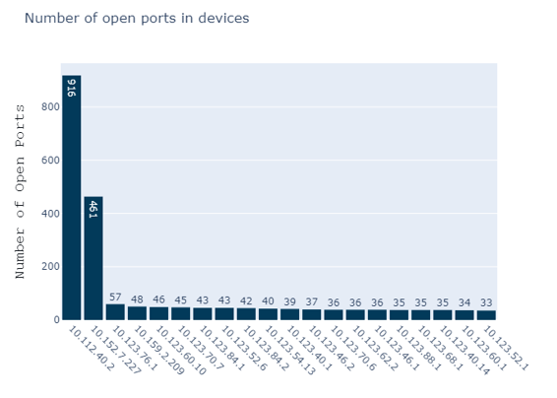
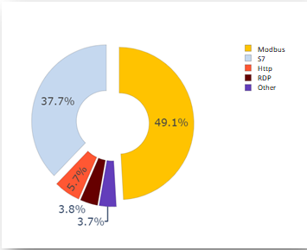
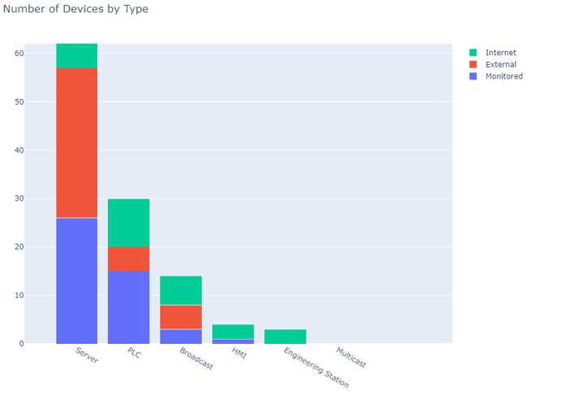
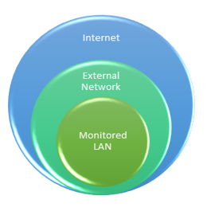
Visibility

Slide 32
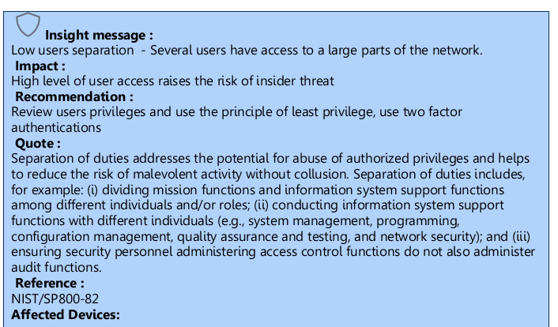
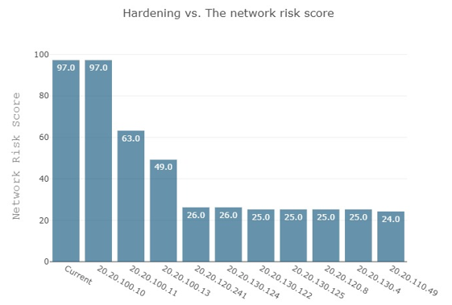
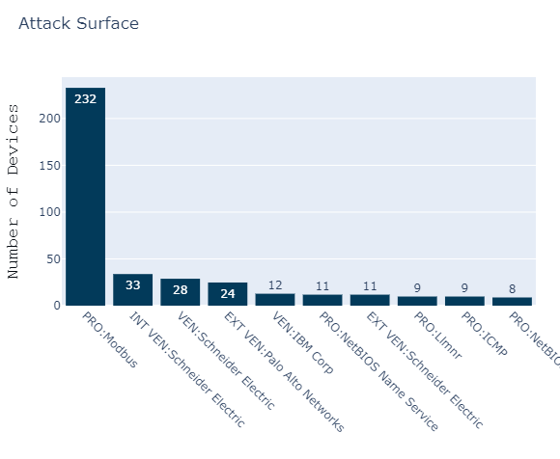
Risk-based Recommendations
Attack Surface Analysis: what vulnerability, if exploited, will affect the largest number of devices?
Descriptive explanations, based on security standards.
Prioritizing devices based on their contribution to the network risk.

Slide 33
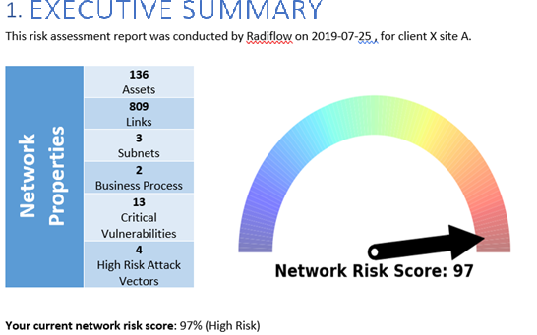
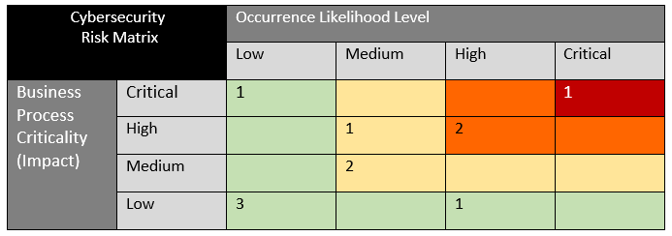
Business Processes Risk
Single-view risk matrix – quickly identifying the risky business process
Executive Summary, risk based.

Slide 34
Summary
We present the Epidemic Threshold and its relation to estimate risk.
We show how this model can be used as part of the NIST Framework.
Can we make Cyber threats “chronic but not a death sentence” to our physical processes?

Slide 35
Summary
We present the Epidemic Threshold and its relation to estimate risk.
We show how this model can be used as part of the NIST Framework.
Can we make Cyber threats “chronic but not a death sentence” to our physical processes? Yes, but…
  More (future) work is needed towards:
“Monitorable” Systems

Slide 36


Thank You!
Q & A
Yehonatan Kfir, CTO
yehonatan_k@radiflow.com
www.radiflow.com

Slide 37
Attacker Model
See Radiflow annual report.

Slide 38
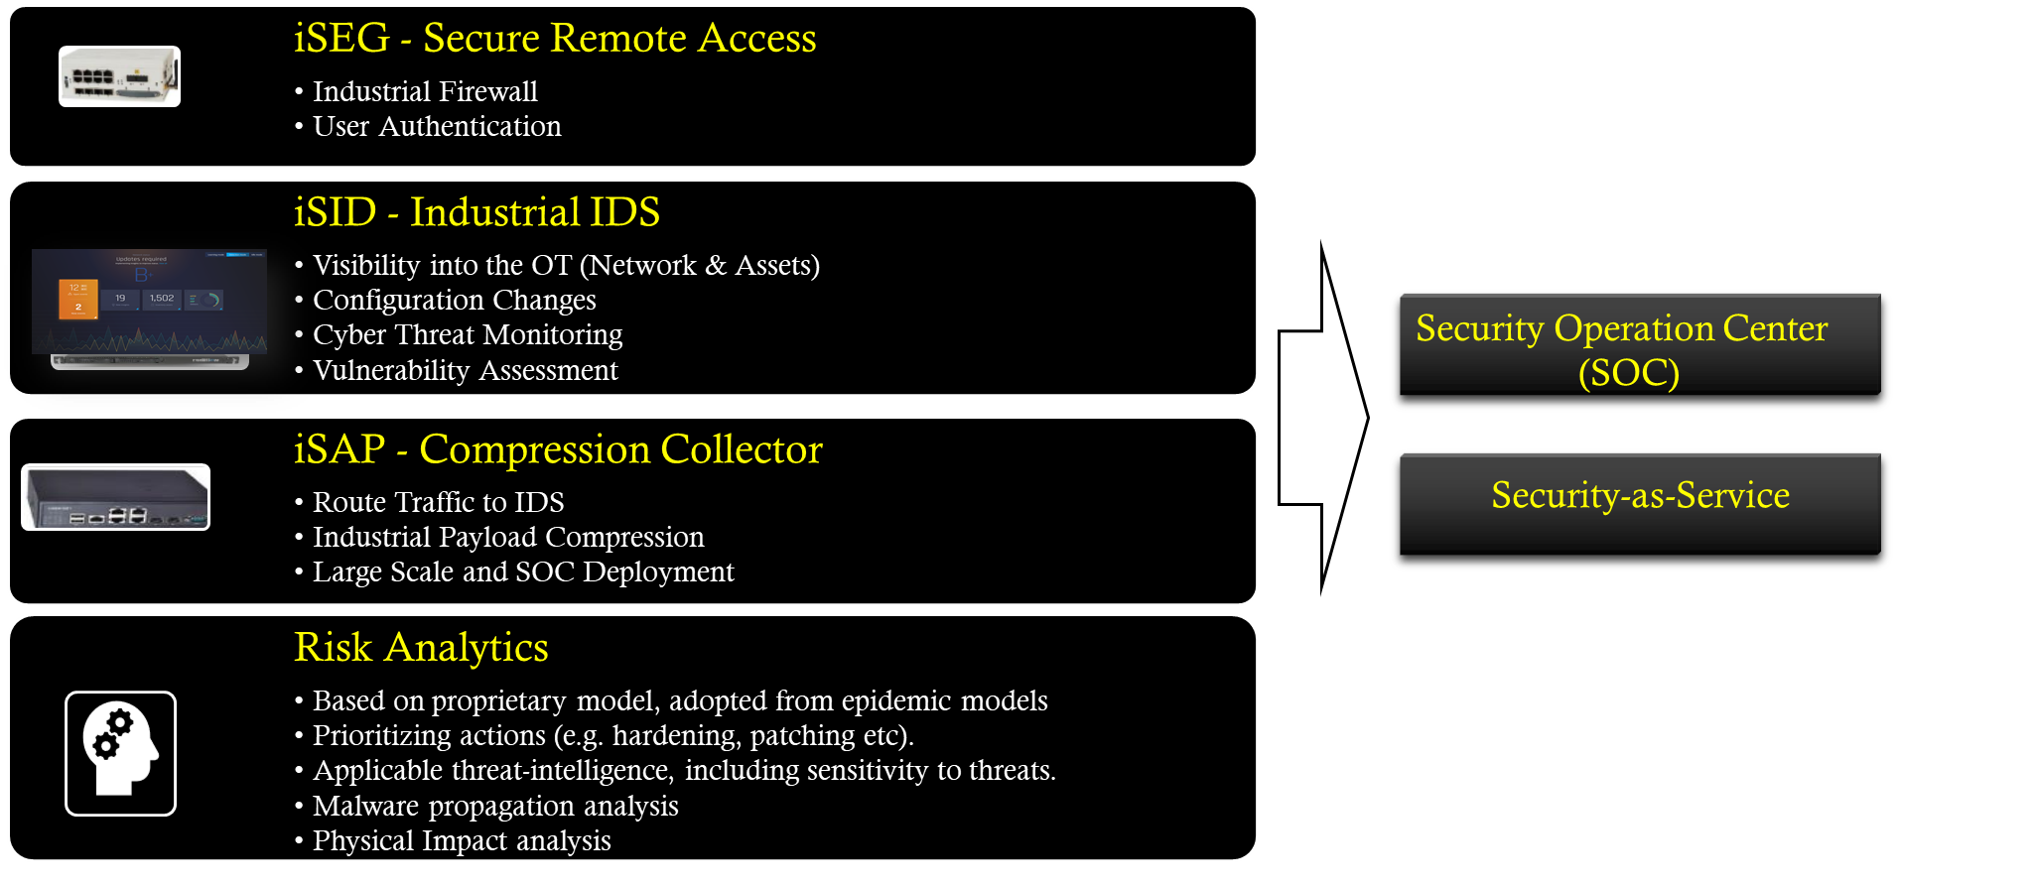
Radiflow Portfolio

