Slide 1
Identity and Access Management for Electric Utilities
Protect Our Power | Best Practices in Utility Cybersecurity Conference
Harry Perper (NIST NCCoE | The MITRE Corporation) January 27, 2020
harry.perper@nist.gov
Notes:
MITRE is a non-profit organization that operates federally funded research and development centers (FFRDCs)

Slide 2
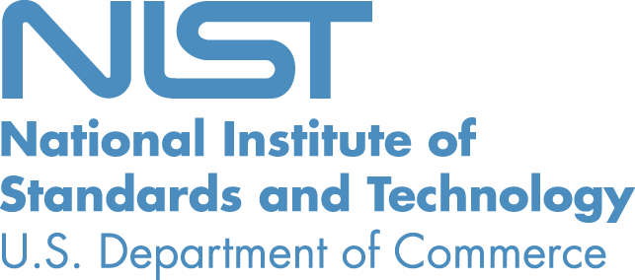
Foundations
harry.perper@nist.gov
Collaborative Hub
The NCCoE assembles experts from businesses, academia, and other government agencies to work on critical national problems in cybersecurity. This collaboration is essential to exploring the widest range of concepts.
As a part of the NIST cyberscurity portfolio, the NCCoE has access to a wealth of prodigious expertise, resources, relationships, and experience.

Slide 3
NCCoE Mission
Accelerate adoption of secure technologies: collaborate with innovators to provide real-world, standards-based cybersecurity capabilities that address business needs
Notes:
Talking points:
We do not create standards
We apply standards to current challenges
We use best practices and commercially available technologies to solve challenges
Goals:
1. Provide practical cybersecurity: Help people secure their data and digital infrastructure by equipping them with practical ways to implement standards-based cybersecurity solutions that are modular, repeatable and scalable
2. Increase rate of adoption: Enable companies to rapidly deploy commercially available cybersecurity technologies by reducing technological, educational and economic barriers to adoption
3. Accelerate innovation: Empower innovators to creatively address businesses’ most pressing cybersecurity challenges in a state-of-the-art, collaborative environment

Slide 4
NCCoE Model
harry.perper@nist.gov

Slide 5
Engagement & Business Model
harry.perper@nist.gov
Define
Assemble
Build
Advocate
Outcome: Define a scope of work with industry to solve a pressing cybersecurity challenge
Outcome: Assemble teams of industry orgs, govt agencies, and academic institutions to address all aspects of the cybersecurity challenge
Outcome: Build a practical, usable, repeatable implementation to address the cybersecurity challenge
Outcome: Advocate adoption of the example implementation using the practice guide

Slide 6
Publications

Slide 7
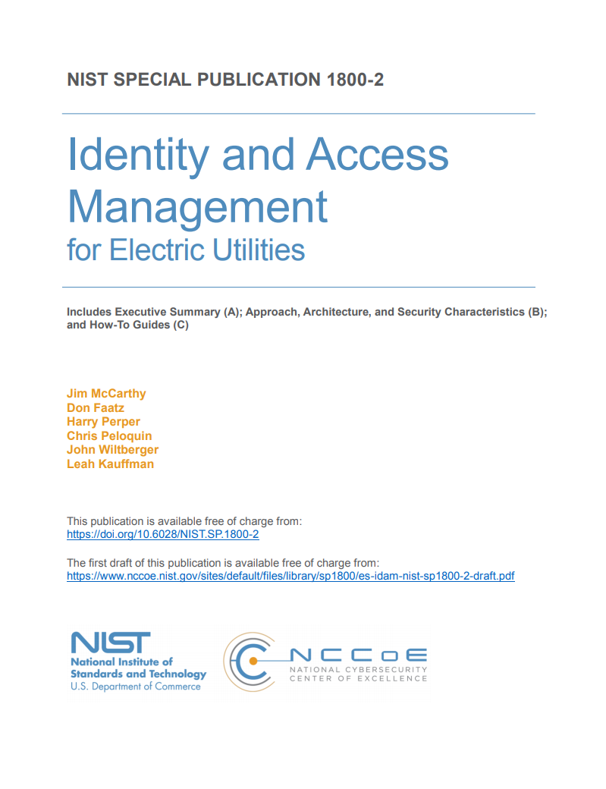
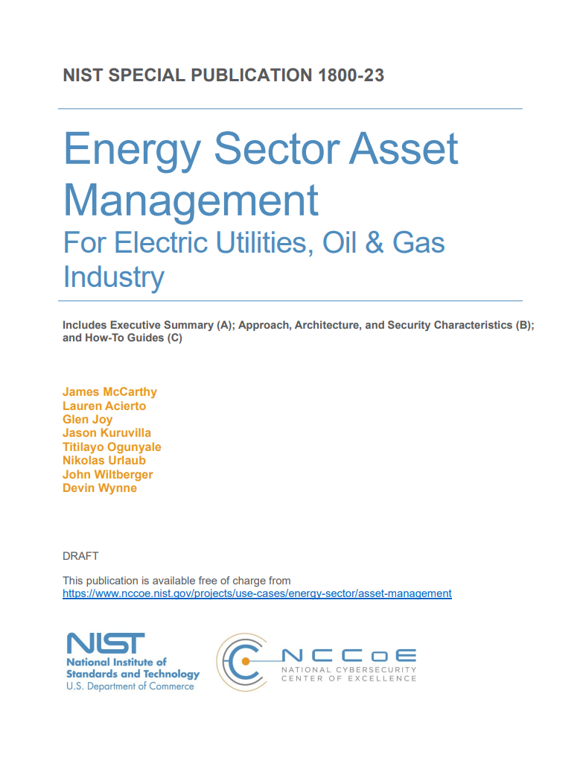
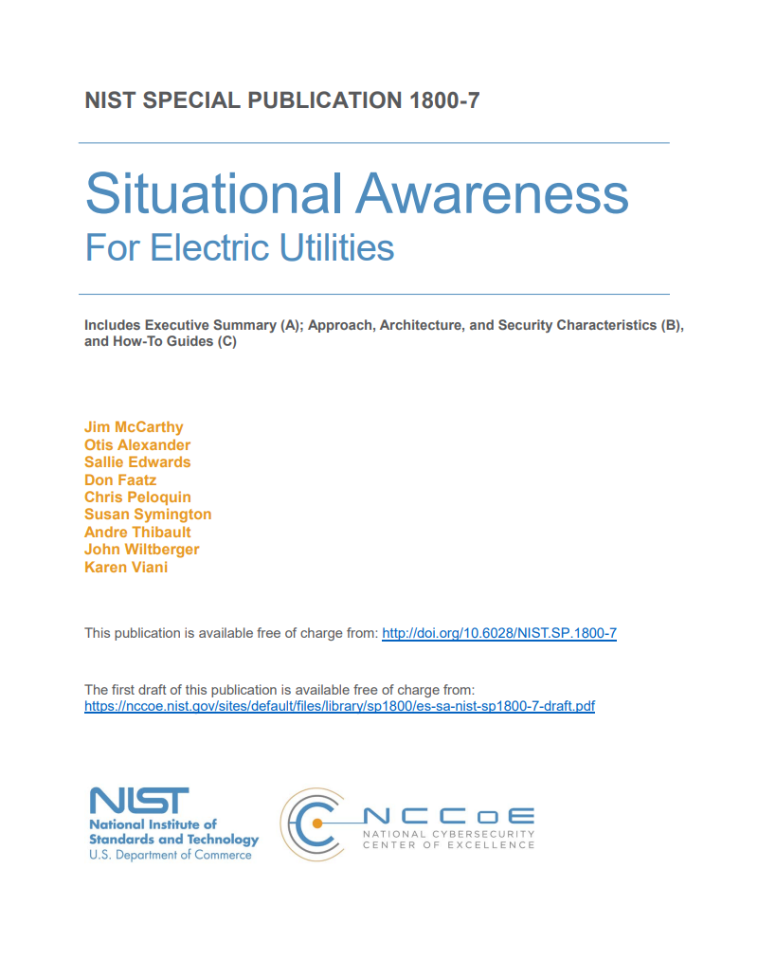
Practice Guides for the Energy Sector
harry.perper@nist.gov
SP 1800-2: Identity and Access Management
SP 1800-23: Energy Sector Asset Management
SP 1800-7: Situational Awareness for Electric Utilities
Control WHO is on your networks and in your facilities
Understand what the people and things on your networks are doing
Know WHAT is on your networks

Slide 8
Portfolio
Attribute Based Access Control (SP 1800-3)
Consumer/Retail: Multifactor Authentication for e-Commerce (SP 1800-17)
Data Integrity: Identifying and Protecting
Data Integrity: Detecting and Responding
Data Integrity: Recovering (SP 1800-11)
Derived PIV Credentials (SP 1800-12)
DNS-Based Email Security (SP 1800-6)
Financial Services: Access Rights Management (SP 1800-9)
Financial Services: IT Asset Management (SP 1800-5)
Financial Services: Privileged Account Management (SP 1800-18)
Healthcare: Securing Electronic Health Records on Mobile Devices (SP 1800-1)
Healthcare: Securing Picture Archiving and Communication Systems (PACS)
Healthcare: Securing Wireless Infusion Pumps (SP 1800-8)
Hospitality: Securing Property Management Systems
Mitigating IoT-Based DDoS
Manufacturing: Capabilities Assessment for Securing Manufacturing Industrial Control Systems
Notes:
This is the current list of NCCoE projects.
Those in blue are sector projects addressing an industry-specific concern.
Those in black are cross-sector projects which do not address a specific industry concern, but rather can be widely applied regardless of sector.
Those with “SP 1800” next to them are projects where the draft practice guide is currently published to the NCCoE website.

Slide 9
Portfolio (continued)
Mobile Device Security: Cloud and Hybrid Builds (SP 1800-4)
Mobile Device Security: Enterprise Builds
Mobile Threat Catalogue
Privacy-Enhanced Identity Federation
Public Safety/First Responder: Mobile Application SSO (SP 1800-13)
Secure Inter-Domain Routing (SP 1800-14)
TLS Server Certificate Mgmt (SP 1800-16)
Transportation: Maritime: Oil & Natural Gas
Trusted Cloud (SP 1800-19)
Notes:
This is the current list of NCCoE projects.
Those in blue are sector projects addressing an industry-specific concern.
Those in black are cross-sector projects which do not address a specific industry concern, but rather can be widely applied regardless of sector.
Those with “SP 1800” next to them are projects where the draft practice guide is currently published to the NCCoE website.

Slide 10
Practice Guide

Slide 11
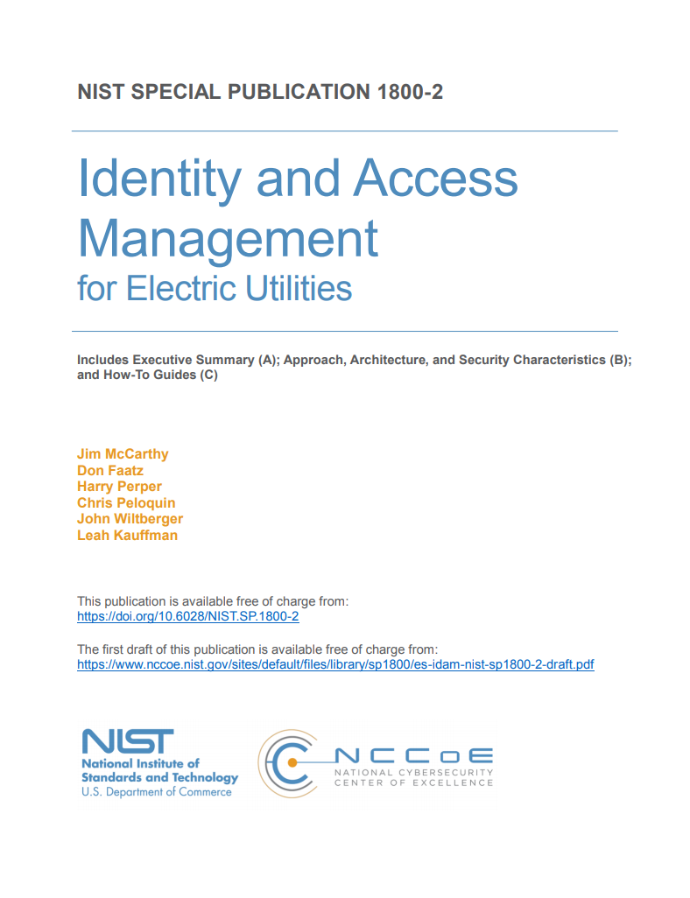
NIST NCCoE SP 1800 Series
Practice Guide Publication
Volume A: Executive Summary
High-level overview of the project, including summaries of the challenge, solution, and benefits
Volume B: Approach, Architecture, and Security Characteristics
Deep dive into challenge and solution, including approach, architecture, and security mapping to NIST Cyber Security Framework (CSF) and other relevant standards
Volume C: How-To Guide
Detailed instructions on how to implement the solution, including components, installation, configuration, operation, and maintenance

Slide 12
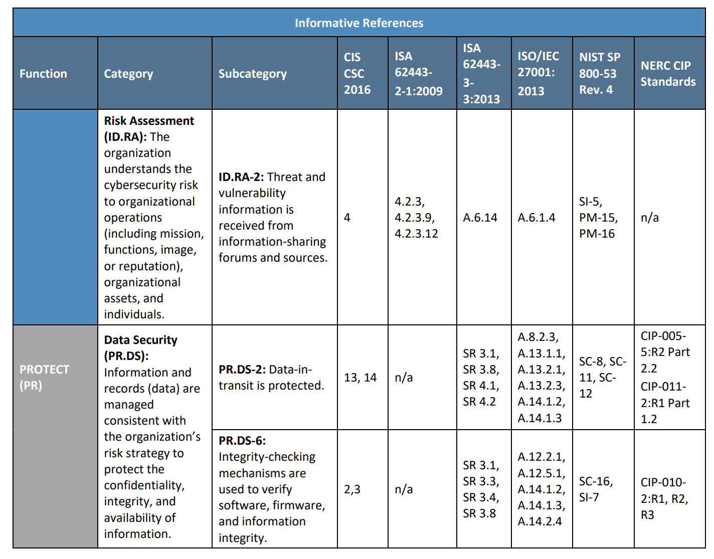
SP 1800 Series
Volume A: Executive Summary
High-level overview of the project, including summaries of the challenge, solution, and benefits
Volume B: Approach, Architecture, and Security Characteristics
Deep dive into challenge and solution, including approach, architecture, and security mapping to NIST Cyber Security Framework (CSF) and other relevant standards
Volume C: How-To Guide
Detailed instructions on how to implement the solution, including components, installation, configuration, operation, and maintenance

Slide 13
Identity and Access Management for the Energy Sector - SP 1800-2
harry.perper@nist.gov

Slide 14
Identity and Access Management: SP 1800-2
Securing networked infrastructure for the energy sector
Overview
Electric companies need to be able to control access to their networked resources
Identity and Access Management (IdAM) implementations are often decentralized and controlled by numerous departments within a company
The IdAM Practice Guide shows how an electric utility can implement a converged IdAM platform to provide a comprehensive view of all users within the enterprise across all silos, and the access rights they have been granted
Define
ASSEMBLE
BUILD
Advocate
Define
ASSEMBLE
BUILD
Advocate
Project Status
Final published July 2018
Collaborate with Us
Download NIST SP 1800-2, Identity and Access Management for Electric Utilities
Email energy-nccoe@nist.gov to join the Community of Interest for this project
Notes:
The practice guide includes three versions of an end-to-end identity management solution that provides access control capabilities to reduce opportunities for cyber attack or human error. It accounts for the risks that converged control can present. In this guide, we show how an electric utility can implement a converged IdAM platform, using multiple commercially available products, to provide a comprehensive view of all users within the electric utility, across all silos, and of the access rights that they have been granted.

Slide 15
What is Identity and Access Management?
IdAM is the discipline of managing the relationship between a person and the resources the person needs to access to perform a job.
IdAM encompasses the processes and technologies by which individuals are identified, vetted, credentialed, authorized access to resources, and held accountable for their use of these resources.
IdAM processes and technologies create digital identity representations of people, bind those identities to credentials, and use those credentials to control access to resources.
1. User Registration
2. Credential Issuance & Management
3. Access Rights Management
4. Provisioning
5. Authentication
6. Access Control
7. Audit
Notes:
The guide:
▪ maps security characteristics to guidance and best practices from NIST and other standards organizations, including NERC CIP Version 5 standards
▪ provides a detailed example solution with capabilities that address security controls, and demonstrates a modular approach that uses different products to achieve the same results
▪ includes instructions for implementers and security engineers, including examples of all of the necessary components and installation, configuration, and integration
▪ uses products that are readily available and interoperable with your existing IT infrastructure and investments
▪ can meet the needs of electric utilities of all sizes, including corporate and regional business offices, power generation plants, and substations

Slide 16
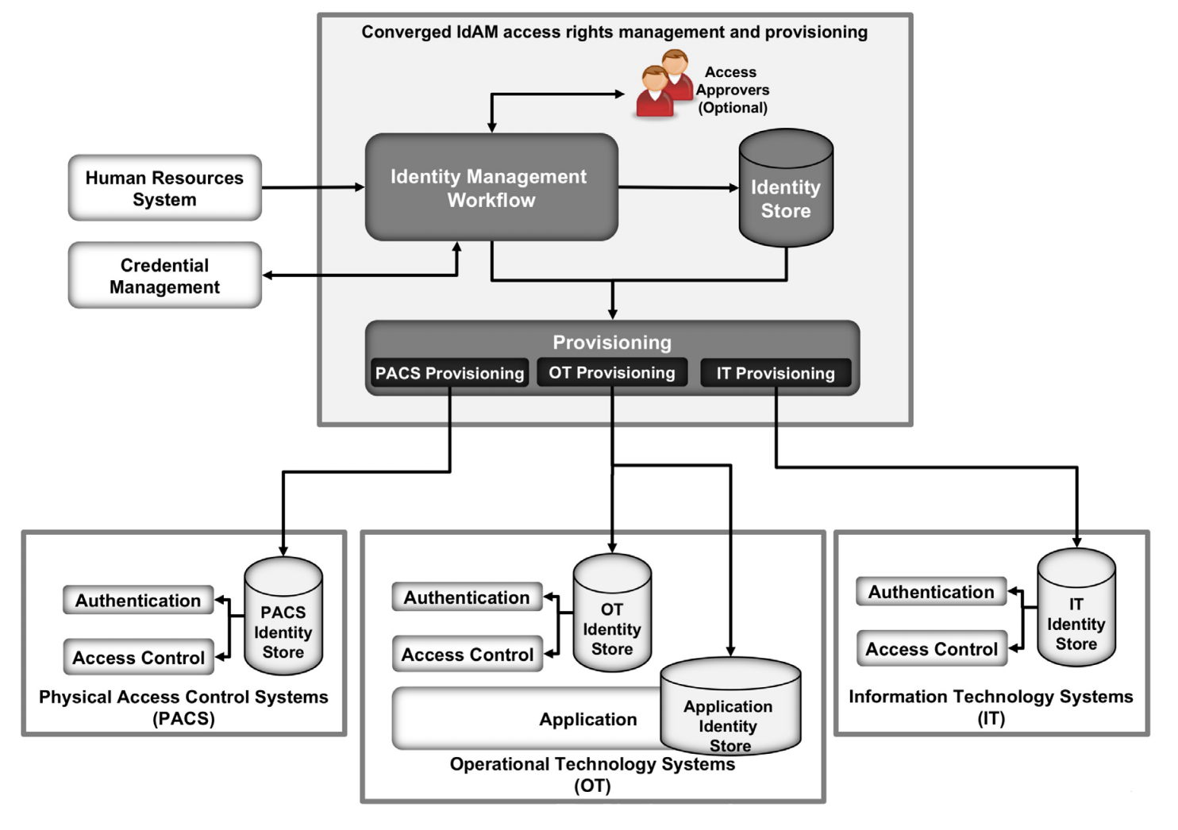
Identity and Access Management: Architecture
Notes:
The experts and utility professionals that we consulted told us that they need to control physical and logical access to their resources, including buildings, environmental applications, energy management system (EMS) control and data centers, equipment, IT, and OT systems. They need to authenticate only designated individuals and devices to which they are giving access rights. In addition, they need to enforce access-control policies (e.g., allow, deny, inquire further) consistently, uniformly, and quickly across all of their resources.
Current IdAM implementations can often be fragmented and controlled by numerous departments within an electric utility or by individual equipment owners. Several negative outcomes can result from this situation: an increased risk of attack and service disruption, an inability to identify potential sources of a problem or attack, and a lack of overall traceability and accountability regarding who has access to both critical and noncritical assets.

Slide 17
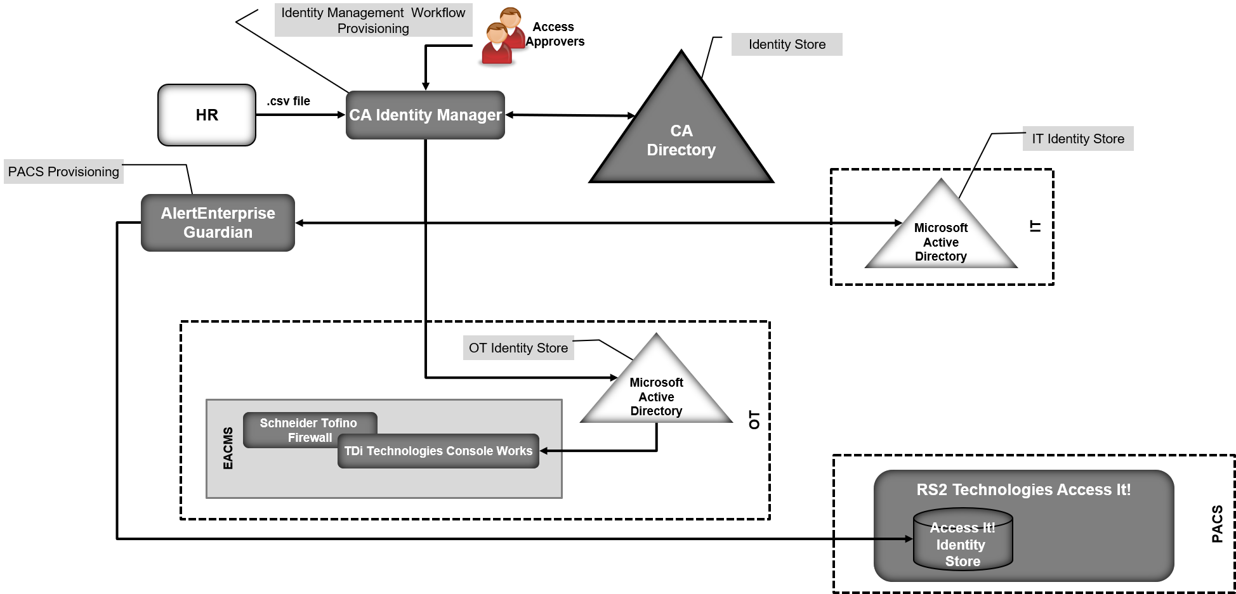
IdAM Lab Implementation
harry.perper@nist.gov
Notes:
In our lab at the NCCoE, which is part of NIST, we built an environment that simulates an electric utility’s architecture. This architecture includes the typical technology silos found in a utility (such as OT, IT, and physical access control systems [PACS]).

Slide 18
SP 1800-2: Potential Outcomes
harry.perper@nist.gov
Adopting all or part of the example implementation can:
Reduce the risk of malicious or untrained people gaining unauthorized access to critical infrastructure components and interfering with their operation
Allow rapid provisioning and de-provisioning of access from a converged platform
Simplify regulatory compliance by automating generation and collection of access information
Improve situational awareness: proper access and authorization can be confirmed via the use of a single, converged solution
Improve security posture by tracking and auditing access requests and other IdAM activity across all networks
Enhance the productivity of employees, support oversight of resources, and speed delivery of services

Slide 19
IdAM Best Practices (partial list*)
Leverage a converged IdAM solution
Centrally manage and monitor authentication, authorization, and access-control requirements for all OT and IT users
Apply the principle of least privilege to (at a minimum):
the central identity and authorization store
the authorization workflow management system
Log all activity that is performed on IdAM components
Deploy all components on securely configured OSs that use 2FA
Segregate IdAM components onto their own network
Require super-administrators to use a console access manager when accessing the console of all devices on the IdAM network
* View the full list at SP 1800-2, Volume B, Section 5.9.6, Evaluation of Security Characteristics
Notes:
The authorization workflow management system is trusted to make changes to the central identity and authorization store. Therefore, any inappropriate or unauthorized use of these systems could change authorization levels for anyone in the enterprise. If that occurred, the enterprise would experience a lack of integrity of the identity and authentication stores.
The central identity and authorization store is the authoritative source for the enterprise and holds the hash for each user password, as well as the authorizations associated with each user. Access to this information would enable an unauthorized user to impersonate anyone in the organization. In this situation, the enterprise would lose control over access to resources.

Slide 20
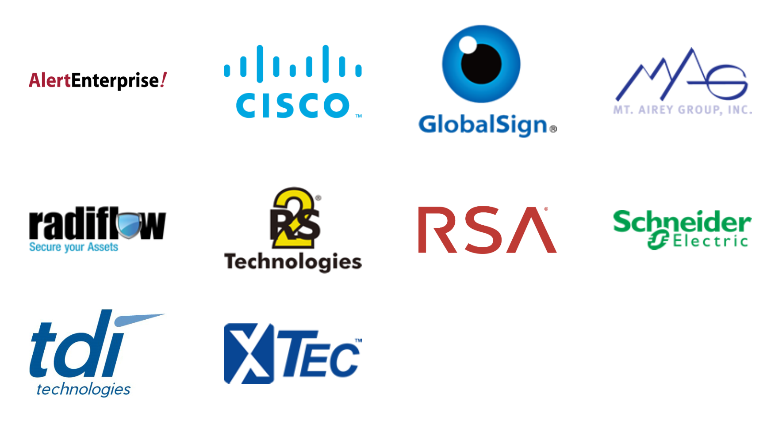
Identity and Access Management: SP 1800-2
Project Collaborators

Slide 21
Questions?
Harry Perper
harry.perper@nist.gov
301-975-0367

Slide 22
Back-up Slides and Additional Information

Slide 23
Energy Sector Asset Management: SP 1800-23
Assessing cyber risk on OT networks
Overview
Industrial control system assets provide command and control information as well as key functions on OT networks, therefore any vulnerabilities in these assets can present opportunities for malicious actors
To properly assess cybersecurity risk within the OT network, energy companies must be able to identify all assets, especially those that are most critical
This project provides a reference architecture and an example solution for managing, monitoring, and baselining assets, and includes information to help identify threats to these OT assets
Define
ASSEMBLE
BUILD
Advocate
Project Status
Published draft on 09/23/2019 Comments being accepted through November 25, 2019
Collaborate with Us
Read Energy Sector Asset Management Practice Guide
Email energy_nccoe@nist.gov to join the Community of Interest for this project

Slide 24
Situational Awareness: SP 1800-7
Improving security for electric utilities
Overview
Energy companies rely on operational technology to control the generation, transmission, and distribution of power
A network monitoring solution that is tailored to the needs of control systems would reduce security blind spots
This project explores methods energy providers can use to detect and remediate anomalous conditions, investigate the chain of events that led to the anomalies, and share findings with other energy companies
Define
ASSEMBLE
BUILD
Advocate
Project Status
Final SP 1800-7 released in August 2019
Collaborate with Us
Download SP 1800-7 Situational Awareness for Electric Utilities
Email energy_nccoe@nist.gov to join the Community of Interest for this project

Slide 25
Securing the Industrial Internet of Things
Cybersecurity for Distributed Energy Resources
Overview
As an increasing number of distributed energy resources (DERs) are connected to the grid, there is a need to examine the potential cybersecurity concerns that may arise from these IIoT connections.
This project focuses on demonstrating data integrity and malware prevention, detection, and mitigation for scenarios in which information exchanges occur between DERs and the distribution grid.
Define
ASSEMBLE
BUILD
Advocate
Project Status
Project Kickoff: December, 2019
Collaborate with Us
Read Project Description: Securing the Industrial Internet of Things
Email energy_nccoe@nist.gov to join the Community of Interest for this project

